Slide 1

Lecture 14
Greedy algorithms
Copyright © 2007 Pearson Addison-Wesley. All rights reserved.

Slide 2
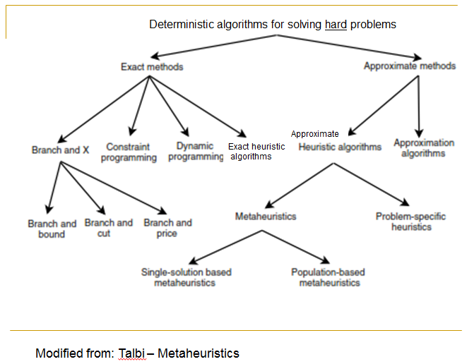
Recall

Slide 3
Greedy Algorithms
They actually use one of the simplest heuristic – the greedy heuristic – choose what at the moment seems the best
Although often they are not called a heuristic method

Slide 4
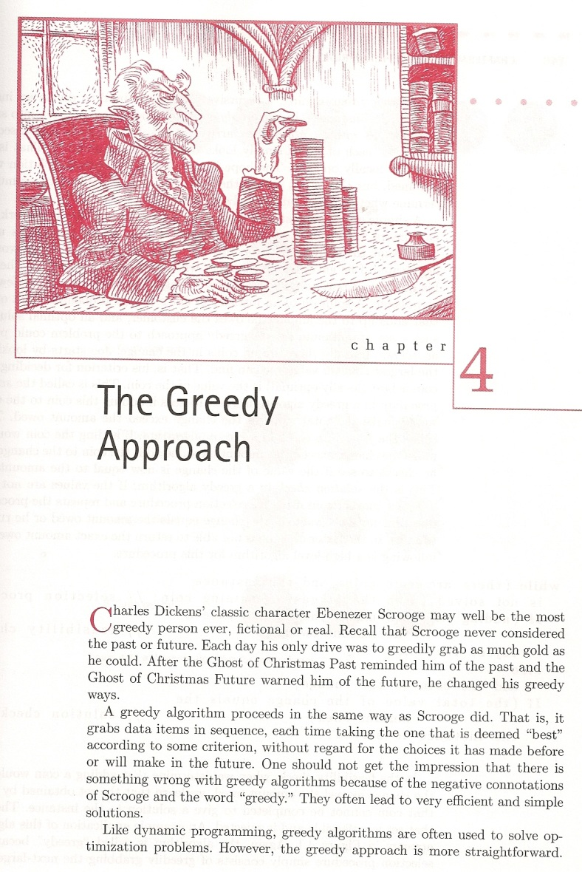
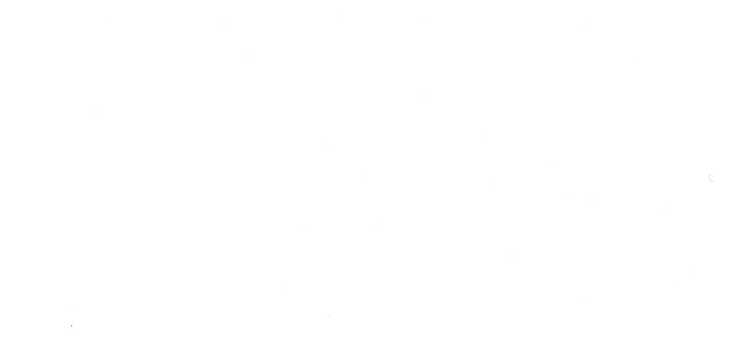
Greedy algorithms
Charles Dickens's 1843 novel, A Christmas Carol

Slide 5
Greedy Algorithms
A greedy algorithm proceeds in the same way as Scrooge did. That is:
it makes choices in sequence,
each time taking the one that is deemed "best"
according to some criterion,
without regard for the choices it has made before
or will make in the future.
One should not get the impression that there is
something wrong with greedy algorithms because of the negative connotations of Scrooge and the word "greedy." They often lead to very efficient and simple
solutions.

Slide 6
Greedy Algorithms
Algorithm works in steps
In each step, a decision is made (based on the current information) that seems to be good, without regard for the future consequences (and usually without regard for previous history)
Generally, this means that some local optimum is chosen.
This "take what you can get now" strategy is the source of the name for this class of algorithms - "Greedy“. At every step, the algorithm chooses the best morsel it can swallow, without worrying about the future.

Slide 7
Greedy Algorithms
More precisely:
Algorithm works in steps
In each step, a choice is made that is:
Feasible – satisfies the problem’s constraints
Locally optimal – is the best local choice among all feasible choices available at that step
Irrevocable – once made cannot be changed on subsequent steps
This is one of the most basic heuristics

Slide 8
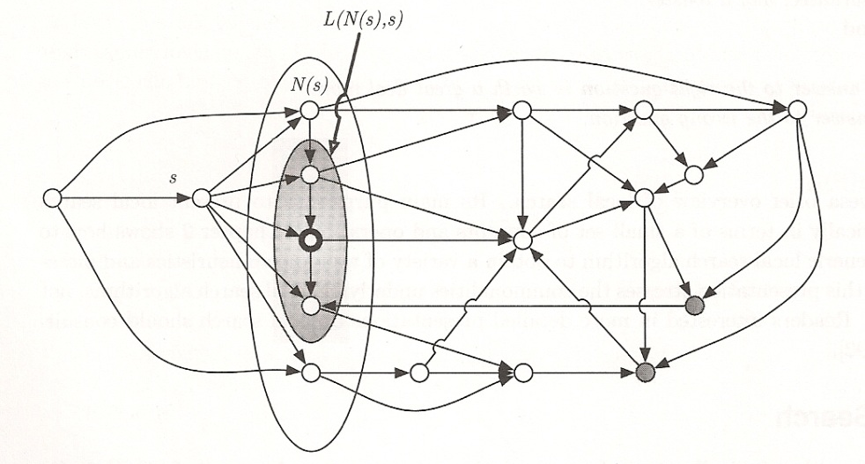
Local Greedy Algorithms
s – current state
N(s) – possible children (neighborhood) of s
L(N(s),s) – legal (feasible, allowed) children
Bold circle – selected child

Slide 9
Greedy Algorithms - Settings
8
Settings
Optimization problem – looking for an optimal state – objective function
“Regular” state space problem in Artificial Intelligence – we use a heuristic function to direct the search – heuristic function

Slide 10
State-Space Landscape
Extension of the state space
In a state-space landscape we have
Location: state
Elevation: value of objective function or heuristic function
Elevation is an additional coordinate
9

Slide 11
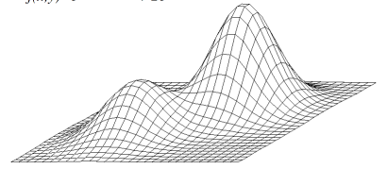
State-Space Landscape
For example, in AI: hill-climbing heuristic algorithm
10
Two-dimensional state-space

Slide 12
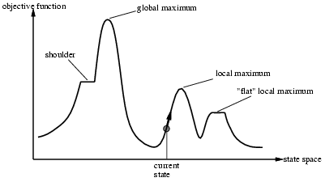
State-Space Landscape
One-dimensional
Can move to the left or to the right in the state space
Location: state
Elevation: value of objective function or heuristic function
or heuristic function
plateau
11

Slide 13
Greedy Algorithms
When the algorithm terminates, we hope that the local optimum is a global optimum.
Some greedy algorithms yield an optimal (precise) solution for every instance. (case A)
Most greedy algorithms don’t but can be useful for fast approximations.
Approximate solutions are used when
Exact algorithm is not known (case B1)
Exact algorithm exists but is too slow (case B2)

Slide 14
Applications of the Greedy Strategy
Optimal solutions:
change making for “normal” coin denominations
minimum spanning tree (Prim’s & Kruskal’s algorithms)
single-source shortest paths (Dijkstra’s algorithm)
simple scheduling problems
Huffman codes
Approximations:
traveling salesperson problem (Nearest-Neighbor algorithm)
bin-packing problem
knapsack problem
other combinatorial optimization problems

Slide 15
Change-Making Problem
Given unlimited amounts of coins of denominations d₁ > … > d_{m} ,
give change for amount n with the least number of coins
Example: d₁ = 1TL, d₂ = 50 kuruş, d₃ = 25k, d₄ =10k, d₅ = 5k,
d₆ = 1k
and n = 48 kuruş
Greedy solution: at each step choose the highest denomination possible
48 – 25 = 23
23 – 10 = 13
13 – 10 = 3 1 @ 25 k
3 – 1 = 2 2 @ 10 k
2 – 1= 1 3 @ 1 k
1 – 1 = 0 6 coins

Slide 16
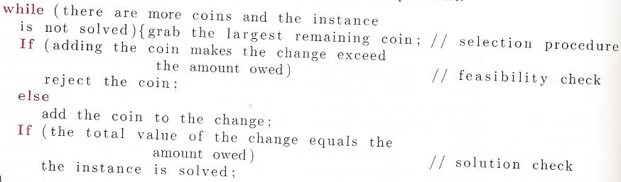
Change-Making Problem

Slide 17
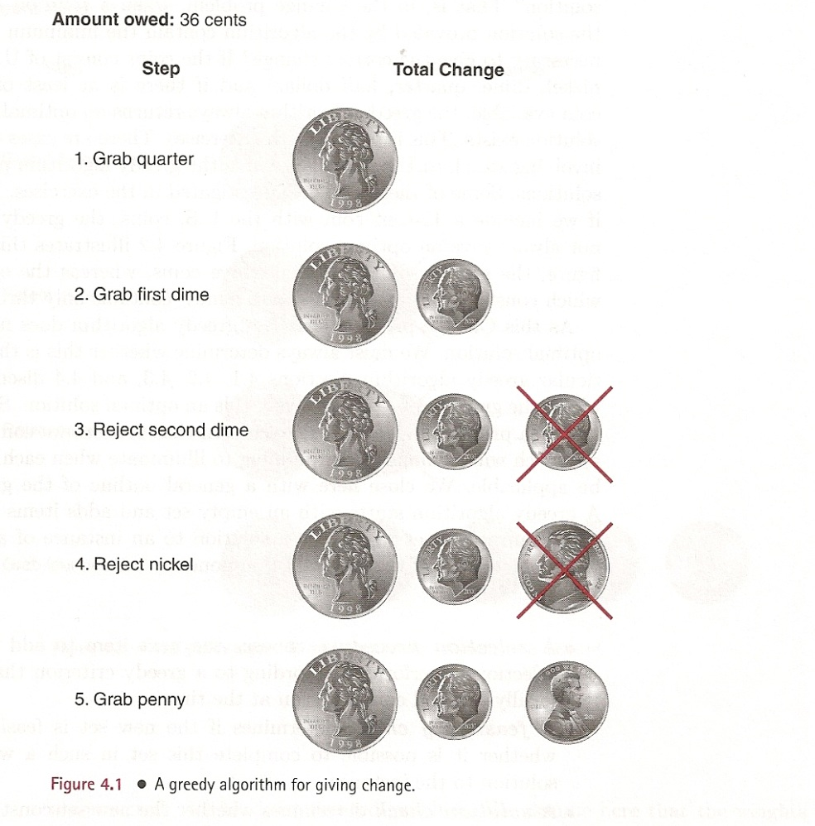
Change-Making Problem
US usual coins:
0.50 half $
0.25 quarter
0.10 dime
0.05 nickel
0.01 penny
$.25
$0.10
$0.05
$0.01

Slide 18
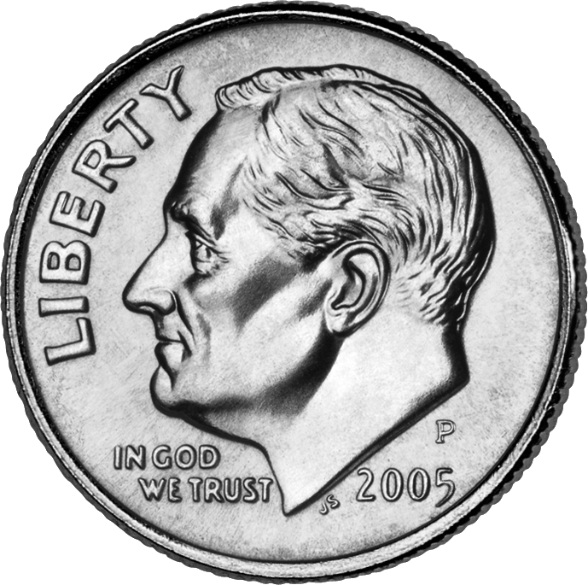
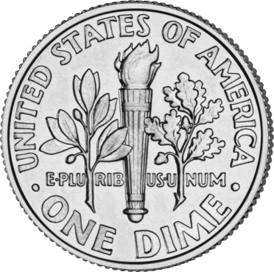
Dime ($0.10)

Slide 19
Recall: Greedy Algorithms
Algorithm works in steps
In each step, a decision is made (based on the current information) that seems to be good, without regard for the previous history and future consequences

Slide 20
Change-Making Problem
Greedy solution is
optimal for any amount and “normal’’ set of denominations
may not be optimal for arbitrary coin denominations
Eg coins with denominations 7, 5, 1
10 1 @ 7 + 3 @ 1 : 4 coins
Better 2 @ 5 : 2 coins

Slide 21
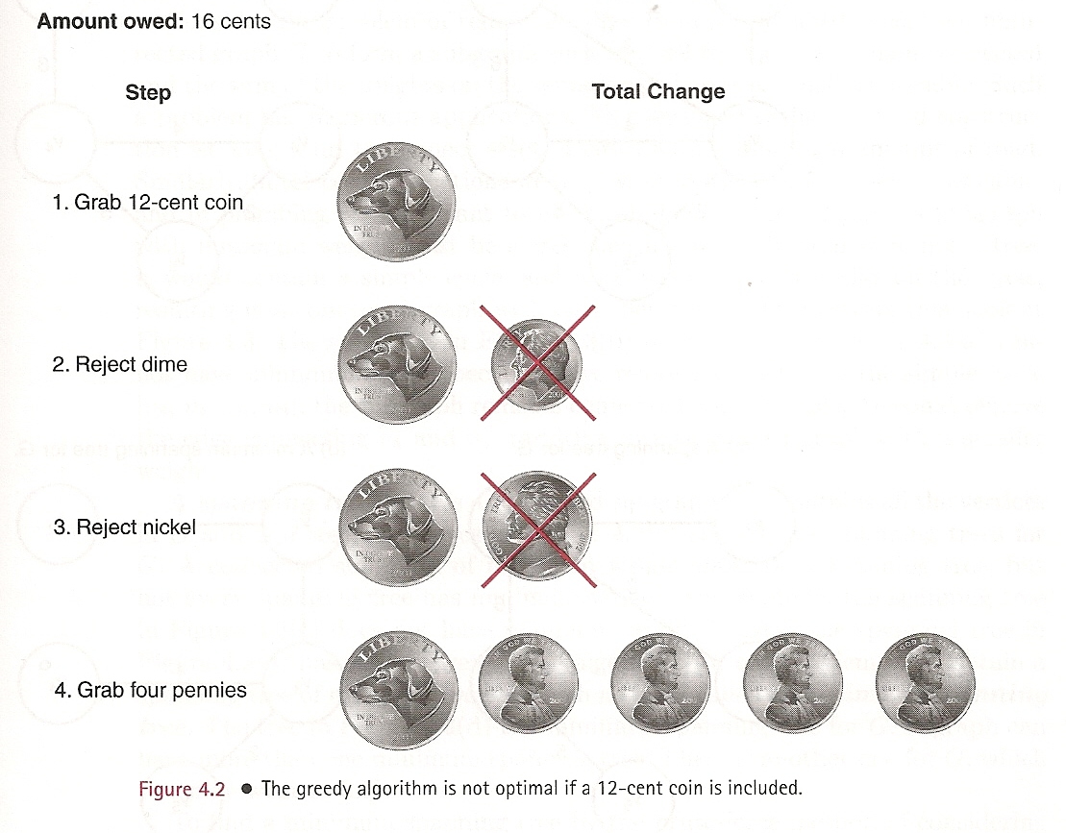
Change-Making Problem
Another not “normal’’ set of denominations
$.12
$0.10
$0.05
$0.01

Slide 22
Works for US$, Euro, TL.

Slide 23
Applications of the Greedy Strategy
Optimal solutions:
change making for “normal” coin denominations
minimum spanning tree (Prim’s & Kruskal’s algorithms)
single-source shortest paths (Dijkstra’s algorithm)
simple scheduling problems
Huffman codes
Approximations:
traveling salesperson problem (Nearest-Neighbor algorithm)
bin-packing problem
knapsack problem
other combinatorial optimization problems

Slide 24
Huffman Codes (Data Compression)
Coding: assignment of bit strings to alphabet characters
Codewords: bit strings assigned for characters of alphabet
Two types of codes:
fixed-length encoding (e.g., ASCII)
variable-length encoding (e,g., Morse code)
Prefix-free codes: no codeword is a prefix of another codeword
coding is unambiguous
Problem: If frequencies of the character occurrences are
known, what is the best binary prefix-free code?
[Best = shortest length of coded text]

Slide 25
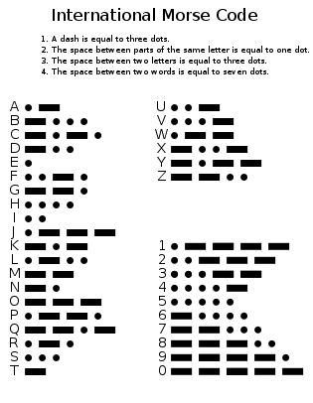
Morse code

Slide 26
Binary tree for the coding
Any binary tree with edges labeled with 0’s and 1’s yields a prefix-free code of characters assigned to its leaves
[or code ‘ala bala skala’]

Slide 27
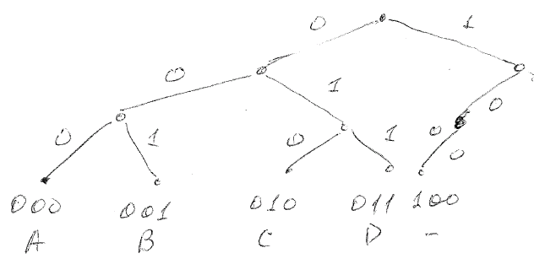
Example
Symbol | Codeword
A | 000
B | 001
C | 010
D | 011
_ | 100
Binary tree
1000 symbols: 3000 bits

Slide 28
Huffman codes
Optimal binary tree minimizing the expected (weighted average) length of a codeword can be constructed as follows
Huffman’s algorithm
Initialize n one-node trees with alphabet characters and tree weights the frequencies of the corresponding character.
Repeat the following step n-1 times: join two binary trees with smallest weights into one (as left and right subtrees) and make its weight equal to the sum of the weights of the two subtrees.
Mark edges leading to left and right subtrees with 0’s and 1’s, respectively.
Notes:
27

Slide 29
Example
character A B C D _
frequency 0.35 0.1 0.2 0.2 0.15
codeword 11 100 00 01 101
length 2 3 2 2 3
repetitions 350 100 200 200 150
bits 700 300 400 400 450
average bits per character: 2.25
for fixed-length encoding: 3
compression ratio: (3-2.25)/3*100% = 25%
1000 symbols: 2250 bits

Slide 30
Analysis
Priority queue (for weighted trees)
Implemented as a heap Θ(nlogn)
Implemented as a list Θ(n²)
I/O takes much more time
Coding table also must be attached
Solution is optimal

Slide 31
Applications of the Greedy Strategy
Optimal solutions:
change making for “normal” coin denominations
minimum spanning tree (Prim’s & Kruskal’s algorithms)
single-source shortest paths (Dijkstra’s algorithm)
simple scheduling problems
Huffman codes
Approximations:
traveling salesperson problem (Nearest-Neighbor algorithm)
bin-packing problem
knapsack problem
other combinatorial optimization problems

Slide 32
The Bin-Packing Problem
We are given n objects of sizes s₁, s₂, …, s_{n}. Pack these objects in the fewest number of bins given the max capacity of a bin is C.
Eg, 2,5,4,7,1,3,8, C=10
Online: every object must be assigned to a bin before the next object arrives
No solution exists – see slide after the next
Offline: all objects are known, then they are assigned to bins
Solution exists, eg by backtracking but is NP-hard [Θ(n^{n})]

Slide 33
Optimal solution
k = 33

Slide 34
No solution for online bin-packing
4,4,6,6 or 4,4,7,7
Where to place the 2nd object
In the first case – better in a separate bin
In the second case – better in the same bin

Slide 35
Online Bin-Packing
Next fit
Try the current bin, otherwise start a new bin
Θ(n)
Worst case – not more than 2M bins (M is the optimal number of bins)
First fit
Start bins from beginning
Θ(n²), Θ(nlogn)
Worst case – not more than 1.7M bins
Average case – only 2% worse than optimum
Best fit
Place in the tightest bin
Θ(n²), Θ(nlogn)
Worst case – not more than 1.7M bins
Average case - better
These methods are approximation algorithms

Slide 36
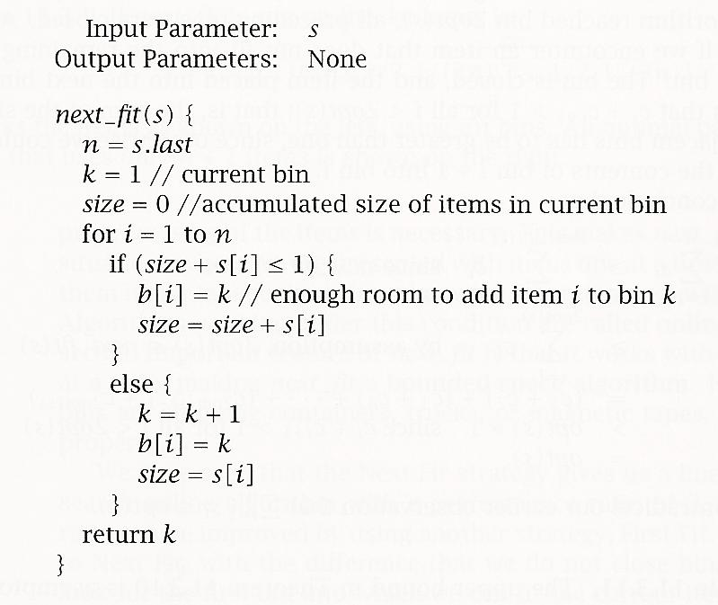
Next fit

Slide 37
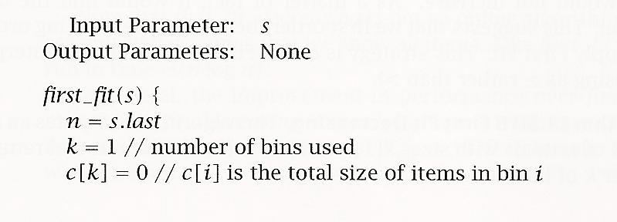
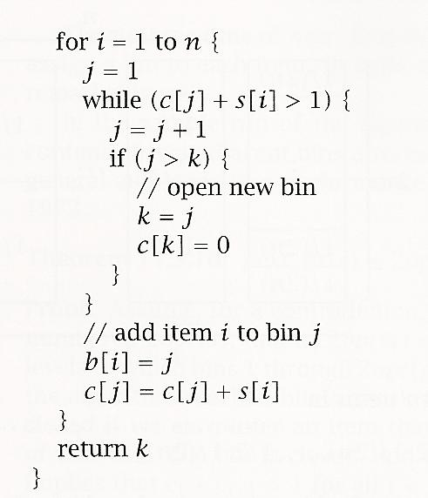
First fit

Slide 38
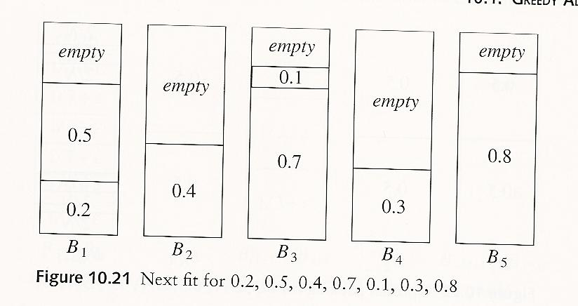
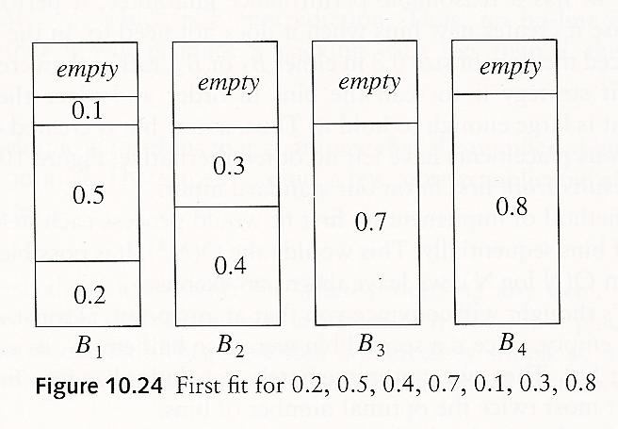
k = 5
k = 4

Slide 39
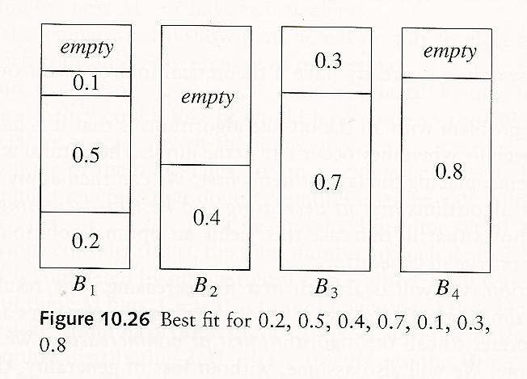
k = 4

Slide 40
For input 2,5,4,7,1,3,6
First fit will give k = 4
Best fit will give k = 3

Slide 41
Offline Bin-Packing
Order and then use one of the same methods
First fit non-increasing
Θ(nlogn)
Worst case – not more than 11/9M+4 bins (≅ 1.1M)
Best fit non-increasing

Slide 42
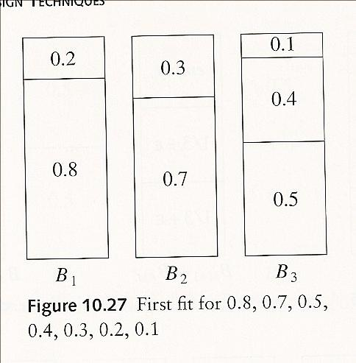
k = 3
nonincreasing

Slide 43
Recall: Greedy Algorithms
When the algorithm terminates, we hope that the local optimum is a global optimum.
Some greedy algorithms yield an optimal solution for every instance. (case A) Huffman codes
Most greedy algorithms don’t but can be useful for fast approximations.
Approximate solutions are used when
Exact algorithm is not known (case B1)
on-line bin-packing
Exact algorithm exists but is too slow (case B2)
off-line bin-packing

Slide 44
Recall: Applications of the Greedy Strategy
Optimal solutions:
change making for “normal” coin denominations
minimum spanning tree (Prim’s & Kruskal’s algorithms)
single-source shortest paths (Dijkstra’s algorithm)
simple scheduling problems
Huffman codes
Approximations:
traveling salesperson problem (Nearest-Neighbor algorithm)
bin-packing problem
knapsack problem
other combinatorial optimization problems
Notes:
43

Slide 45
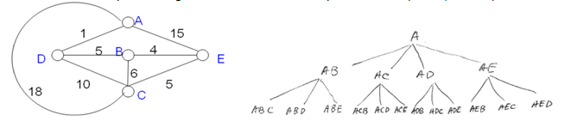
Recall: Travelling Salesperson Problem

Slide 46
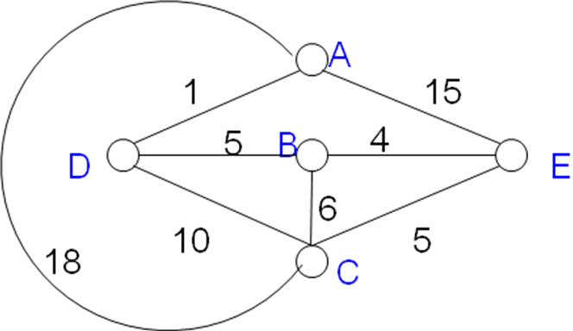
Travelling Salesperson Problem
“A salesperson has a list of cities, each of which (s)he must visit exactly once before returning to the initial city. There are direct roads between some pairs of cities as shown on a map. Find the route the salesperson should follow for the shortest possible round trip that both starts and finishes at the same given home city of the salesperson.”

Slide 47
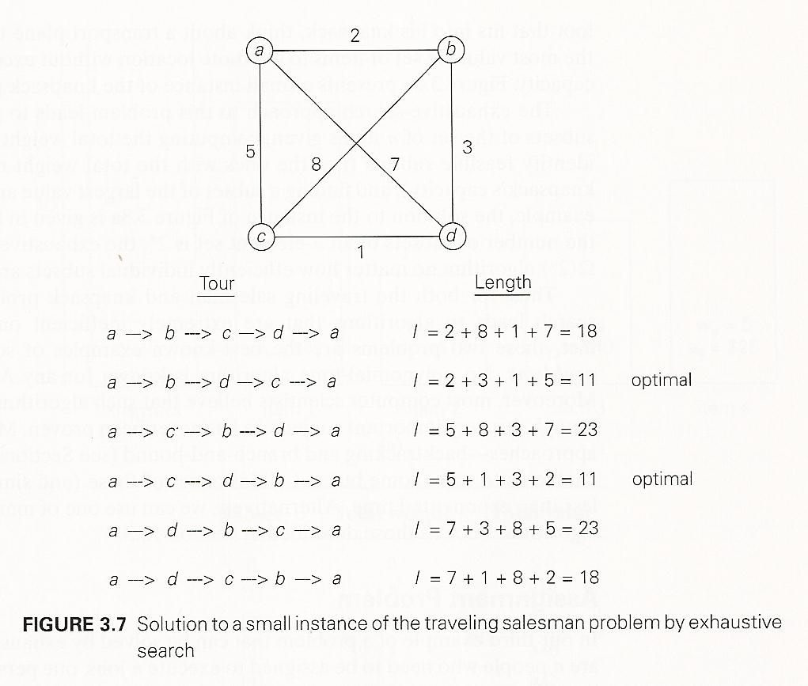
Recall: Travelling Salesperson Problem
All permutations of cities without A

Slide 48
Recall: Travelling Salesperson Problem
(n-1)! possible paths
Without symmetry: (n-1)!/2 paths
Θ(n!) problem
n! possible paths if home city not fixed
Brute force

Slide 49
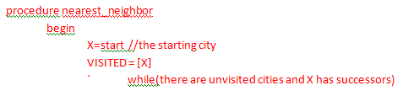
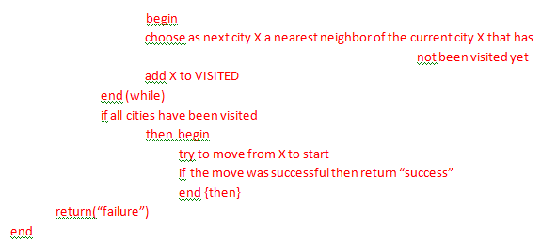
The Nearest-Neighbour Algorithm

Slide 50
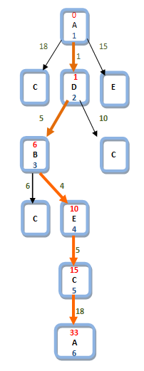
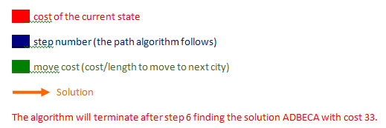
The Nearest-Neighbour Algorithm
ADBCEA and AECBDA: length 32

Slide 51
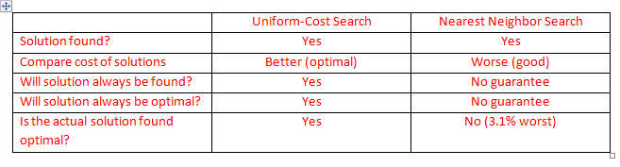
The Nearest-Neighbour Algorithm
e
Many more steps
6 steps

Slide 52
Shortest paths – Dijkstra’s algorithm
Single Source Shortest Paths Problem: Given a weighted (non-negative weights) connected graph G, find shortest paths from given source vertex s to each of the other vertices
Dijkstra’s algorithm:
Among vertices
not already in the tree, it finds vertex u with the smallest sum
d_{v} + w(v,u)
where
v is a vertex for which shortest path has been already found on preceding iterations (such vertices form a tree)
d_{v} is the length of the shortest path form source to v w(v,u) is the length (weight) of edge from v to u

Slide 53
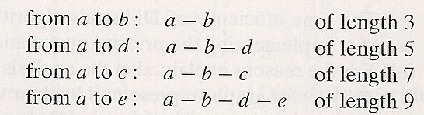
Example
b
4
c
3
6
7
2
5
4
a
d
d
e
Current vertex Remaining vertices [priority queue]
a(-,0) b(a,3) c(-,∞) d(a,7) e(-,∞)
a(-,0) b(-, ∞) c(-,∞) d(-, ∞) e(-,∞)
4
b
c
3
2
6
5
a
7
d
4
e
b(a,3) c(b,3+4) d(b,3+2) e(-,∞)
b
4
c
3
6
updated to 5
2
5
a
7
d
4
e
d(b,5) c(b,7) e(d,5+4)
b
4
c
3
6
not updated to 10
2
5
a
7
d
4
e
c(b,7) e(d,9)
4
b
c
3
6
2
5
a
7
d
4
e
e(d,9)

Slide 54
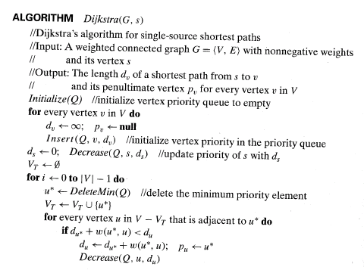
Shortest paths – Dijkstra’s algorithm

Slide 55
Another version

Slide 56
Another example

Slide 57
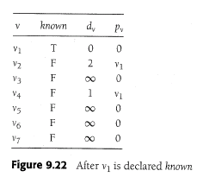

Slide 60
Notes on Dijkstra’s algorithm
Finds optimal solution
Doesn’t work for graphs with negative weights
Applicable to both undirected and directed graphs
Efficiency
O(|V|²) for graphs represented by weight matrix and array implementation of priority queue
O(|E|log|V|) for graphs represented by adjacency lists and min-heap implementation of priority queue

Slide 61
Dijkstra’s algorithm
Demo: see the graph at http://www.answers.com/Dijkstra's+algorithm?gwp=11&ver=2.4.0.651&method=3

Slide 62
Greedy Algorithms
Algorithm works in steps
In each step, a decision is made (based on the current information) that seems to be good, without regard for the previous history and future consequences

Slide 63
Greedy Algorithms
More precisely:
Algorithm works in steps
In each step, a choice is made that is:
Feasible – satisfies the problem’s constraints
Locally optimal – is the best local choice among all feasible choices available at that step
Irrevocable – once made cannot be changed on subsequent steps

Slide 64
Greedy Algorithms
When the algorithm terminates, we hope that the local optimum is a global optimum.
Some greedy algorithms yield an optimal (precise) solution for every instance. (case A)
Most greedy algorithms don’t but can be useful for fast approximations.
Approximate solutions are used when
Exact algorithm is not known (case B1)
Exact algorithm exists but is too slow (case B2)

Slide 65
Recall: Applications of the Greedy Strategy
Optimal solutions:
change making for “normal” coin denominations
minimum spanning tree (Prim’s & Kruskal’s algorithms)
single-source shortest paths (Dijkstra’s algorithm)
simple scheduling problems
Huffman codes
Approximations:
traveling salesperson problem (Nearest-Neighbor algorithm)
bin-packing problem
knapsack problem
other combinatorial optimization problems
Notes:
64

Slide 66
Summary
Greedy algorithms are usually very easy to invent, simple to implement, very efficient
However, for many hard problems the approach is too week and the solutions obtained are not good enough (eg for TSP)
Greedy algorithms can be characterized as being 'short sighted', and as 'non-recoverable'.

Slide 67
Iterative improvement vs. Greedy algorithm
Greedy algorithms above use incremental formulation – the solution is constructed by adding a locally optimal piece to a partially constructed solution starting from an empty solution [Levitin 371, Hromkovic 145]
In the literature this is known as Greedy algorithms
Other applications of the ‘greedy idea’ also exist
Iterative improvement algorithms use a complete-state formulation – the algorithm starts from an initial feasible solution and each step involves some local change which improves the value of the objective function. This, in a sense, is also a greedy approach.

Slide 68
Greedy algorithms in AI
In AI setting (a heuristic function instead of an objective function) the greedy algorithm is actually called (steepest-accent) hill-climbing.
Greedy local search = hill climbing [in our definition before is greedy always local?]
There are many variants of hill-climbing.

Slide 69
Greedy algorithms in AI
Best-first search and A* are greedy systematic search algorithms
Our greedy algorithms before are actually local search

